Slide 1
Project 7
Michel brun
Sandrine prevot
Sarah leouffre

Slide 2
PROCESS
Trello
Planning and detailing all steps
Data cleaning
Missing values, data types, outliers, encoding
Models investigation
Logistic regression, NuSVC, BernoulliNB, AdaBoostClassifier
Choice of model
EDA
Required charts on python

Slide 3
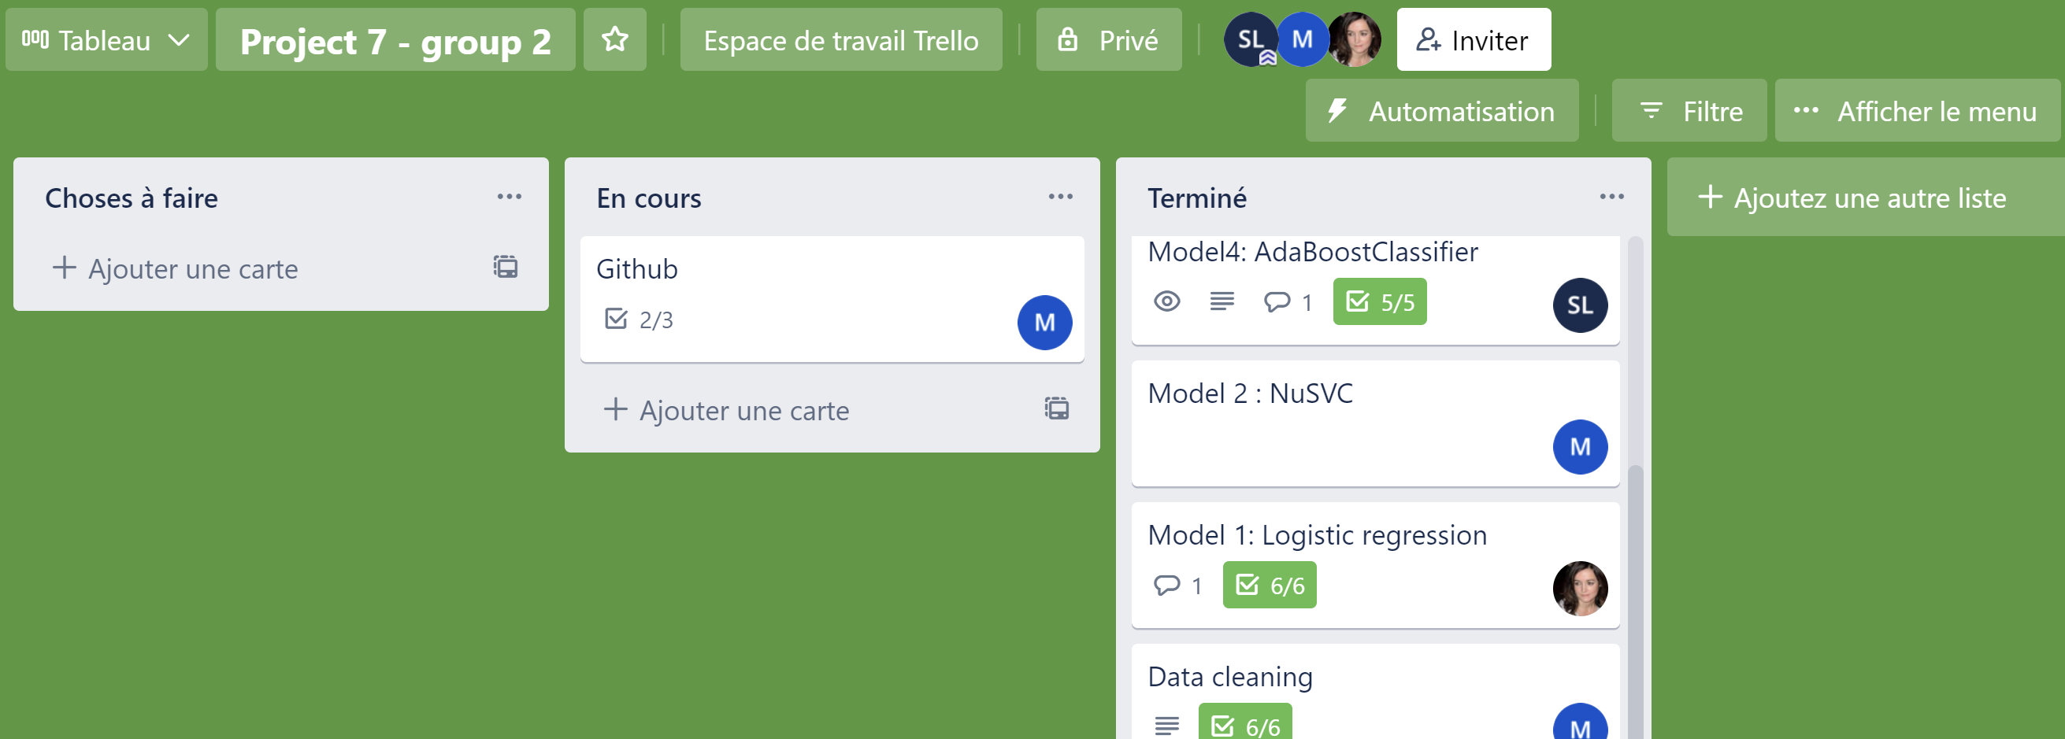
TRELLO

Slide 4
DATA CLEANING
No duplicates found
Missing values:
Droping rows where « rating » value is missing
Input « unknown » to categorical missing data
Runtime column:
Removing rows with kind « movies » and runtime over 400mn
Filling resting missing values with mean value of their specific genre
Splitting categorical data when they were grouped, and keeping at most the two first values
Checking for outliers
Encoding categorical data using LabelEncoder

Slide 5
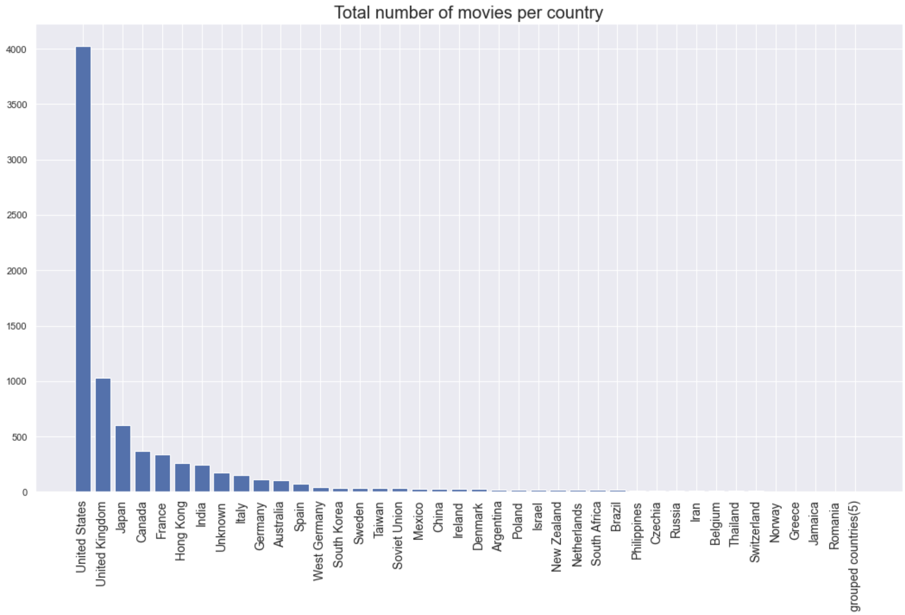
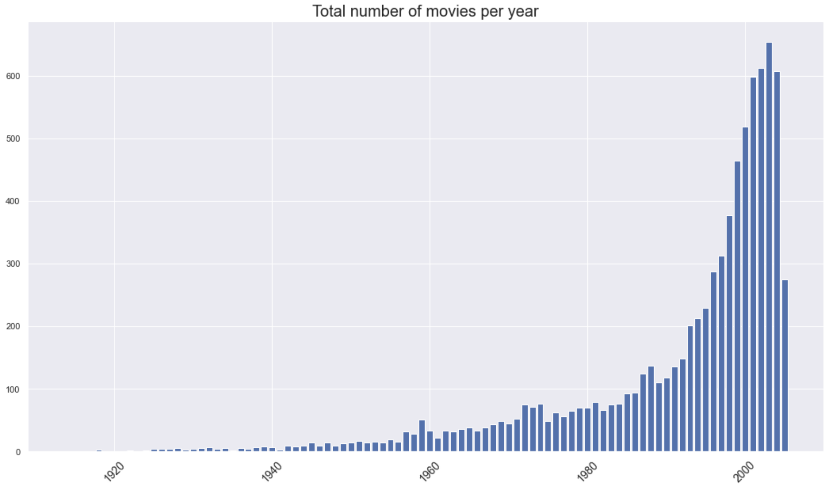
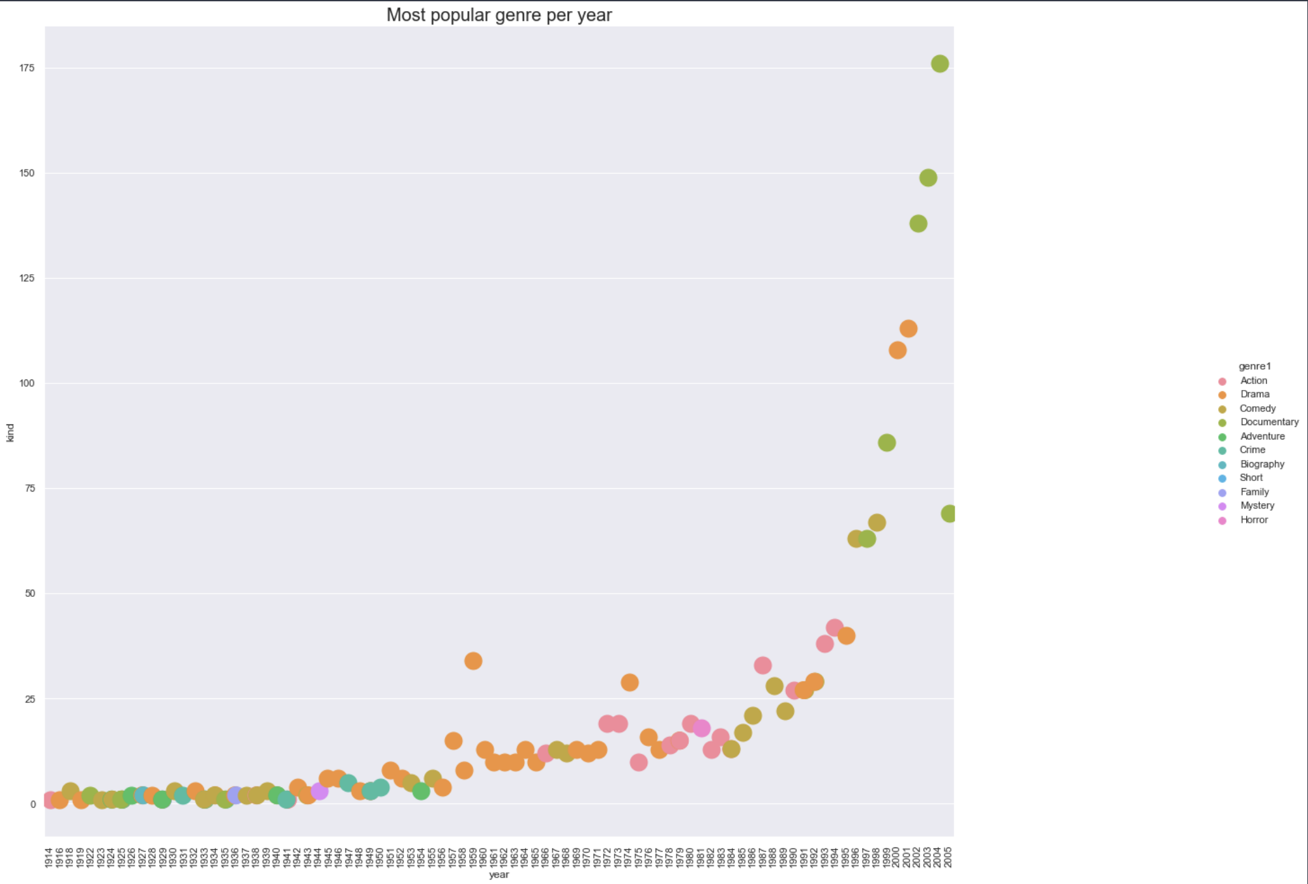
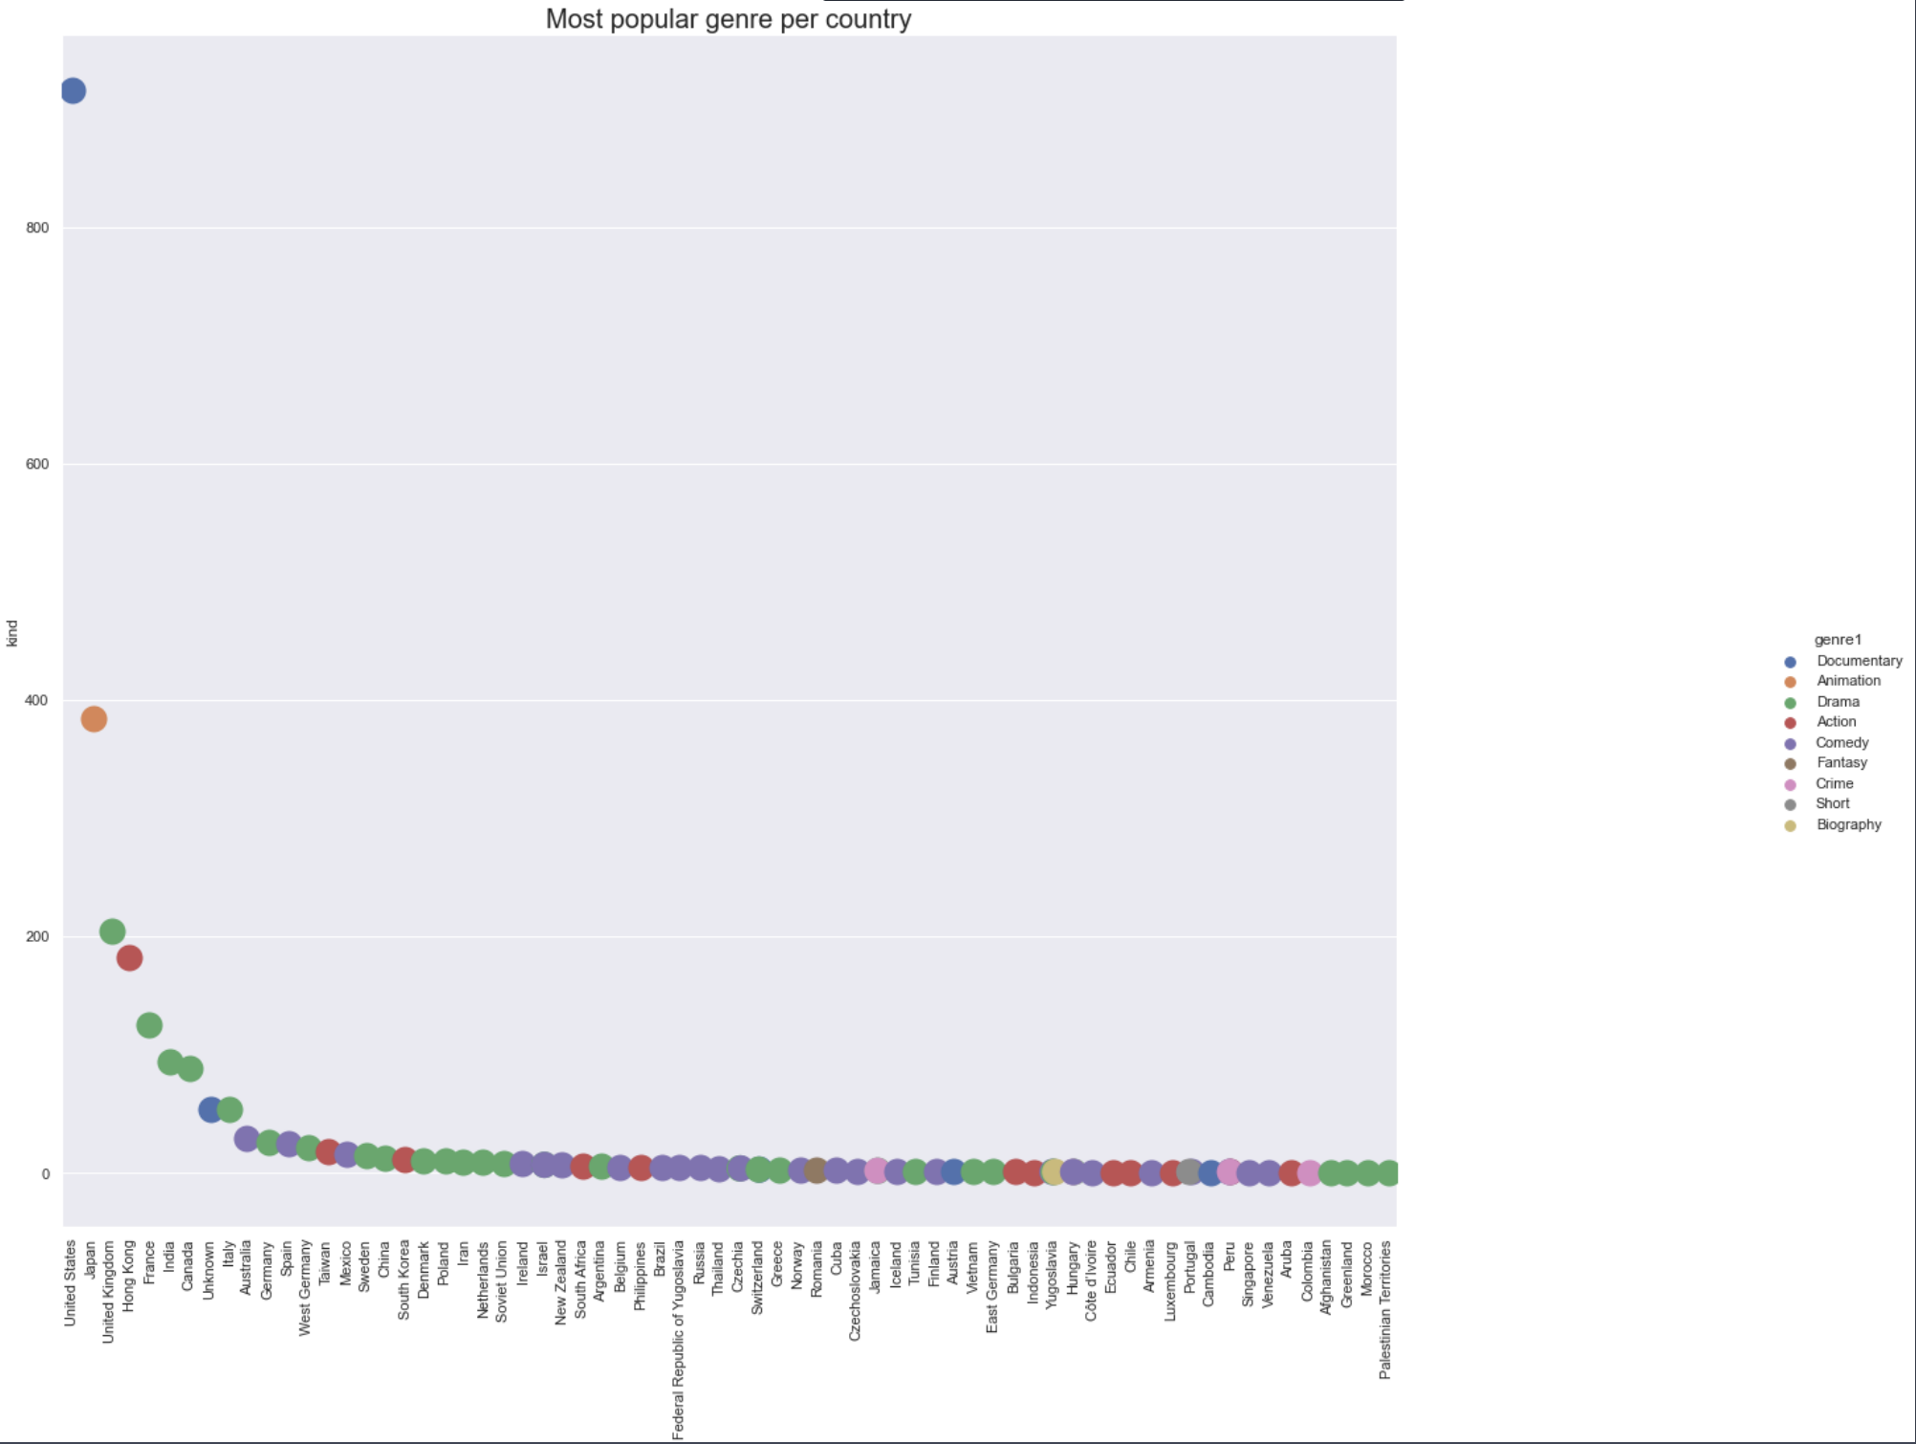
EDA

Slide 6
MODELS INVESTIGATION
Logistic Regression
NuSVC
BernouilliNB
AdaBoostClassifier
Accuracy: 35,75%
Accuracy: 22,43%
Accuracy: 31,90%
Accuracy: 34,51%

Slide 7
CHOICE OF MODEL
No good accuracy score that would permit us to choose a model

Slide 8
THANK YOU

